Slide 1
CS3103 Operating System
POSIX Threads Programming - II

Slide 2
Semaphore
POSIX semaphore types and functions are in <semaphore.h>
Header
#include <semaphore.h>
Declaration
sem_t mysem;
API calls
sem_init(&mysem, 0, initialvalue);
2nd argument 0 indicating this semaphore is to be shared between the threads of a process
sem_wait(&mysem);
It atomically decreases the value of the semaphore by 1
If the value of the semaphore becomes negative, the calling thread blocks

Slide 3
Semaphore
API calls
sem_post(&mysem);
It atomically increases the value of the semaphore by 1
It wakes up a blocked thread waiting on the semaphore, if any
sem_getvalue(&mysem, &value);
If one or more threads are currently blocked on the semaphore, then the returned value is 0 in Linux, else it returns the current value of the semaphore in value
In several other implementations, if one or more threads are currently blocked on the semaphore, the returned value is a negative number whose absolute value is the number of blocked threads
sem_destroy(&mysem);
Reminder: return 0 on success or -1 on error

Slide 4
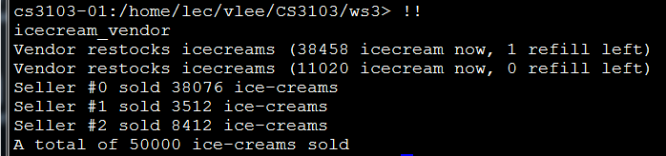
Semaphore – Code Example
Tryout 1
Copy icecream_vendor.cpp from Canvas to your directory in cs3103-01 server. Compile and run it.
A vendor refills 10,000 icecreams twice to the stock. But it may be scheduled to execute at any time (mostly before all sellers).

Slide 5
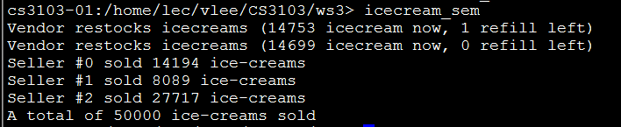
Semaphore – Code Example
Tryout 2
/* icecream_sem.cpp */
#include <semaphore.h>
…
#define LOWSTOCK 5000
…
sem_t refill;
void* seller(void *arg) {
…
if (icecream == LOWSTOCK)
sem_post(&refill);
…
}
void* vendor(void *arg) {
…
sem_wait(&refill);
…
}
Update the program so that the vendor is blocked at the beginning and only refills the stock after signaled by the seller at low stock.
void* main(void *arg) {
…
sem_init(&refill, 0, 0);
…
sem_destroy(&refill);
}

Slide 6
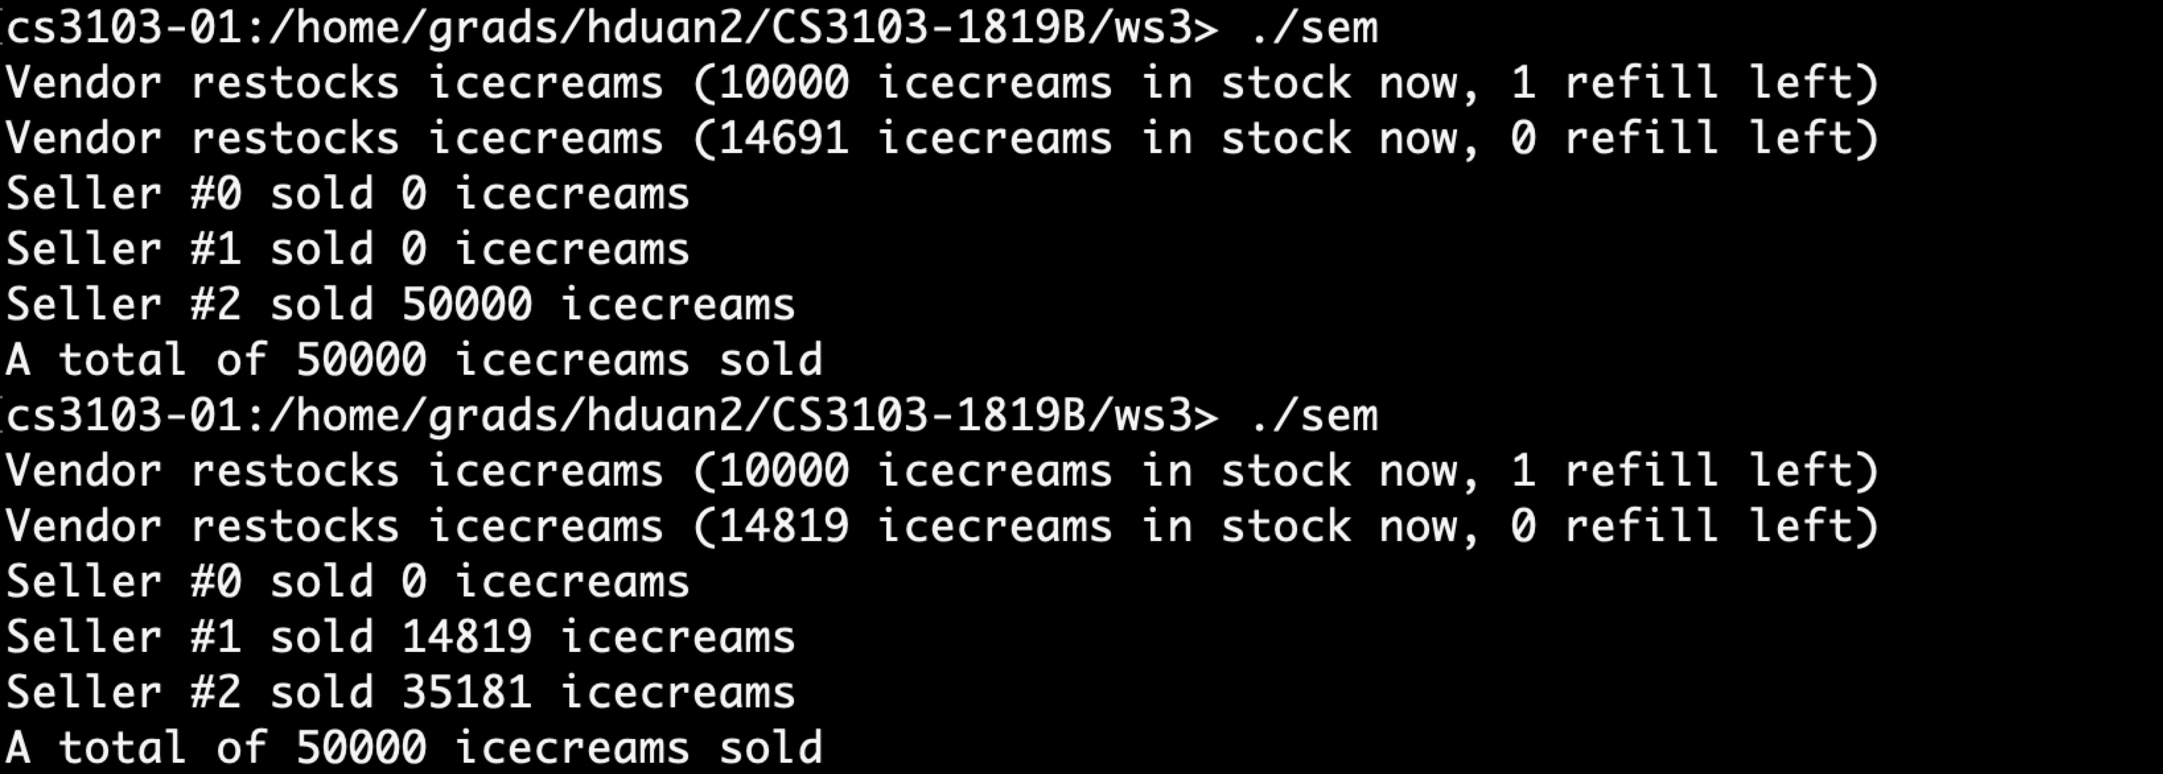
Semaphore – Output Example
In Tryout 2, the vendor is signaled by the seller at low stock, i.e., 5000. However, the vendor may not do the refill right on time (i.e., exactly at the moment when the stock drops to 5000).

Slide 7
Semaphore – Code Example
Reason: After a seller calls sem_post(&refill) and wakes up the vendor, the sellers and vendor will compete for the mutex, so that the vendor may not acquire the mutex immediately.
void* seller(void *arg) {
…
pthread_mutex_lock(&mutex);
…
}
void* vendor(void *arg) {
…
sem_wait(&refill);
…
pthread_mutex_lock(&mutex);
…
}
sellers may acquire the mutex
before the awakened vendor!

Slide 8
Semaphore – More Usage
Tryout 3
Can we make sure that refilling happens exactly at the moment when the stock drops to 5,000 so that the number of ice-creams after refilling is 15,000?
In particular, we want
After sem_post(&refill), the vendor must be the right next one to acquire the mutex, before any seller.
During refilling, no seller can sell.
(This may be guaranteed by the mutex already.)
After refilling, the vendor should notify sellers to resume selling. (This requires signaling between different threads!)
Idea: use another semaphore sell with a Boolean control variable refilling to achieve the goal.

Slide 9
Semaphore – Code Example
Tryout 3
Update the program so that refilling occurs at exactly the low stock.
void* seller(void *arg) {
…
sem_wait(&sell);
…
if (refill_cnt > 0) {
refilling = true;
sem_post(&refill);
}
…
if(!refilling)
sem_post(&sell);
…
}
void* vendor(void *arg) {
…
refilling = false;
sem_post(&sell);
…
}
…
sem_t refill;
sem_t sell;
bool refilling = false;
…
void* main(void *arg) {
…
sem_init(&refill, 0, 0);
sem_init(&sell, 0, 1);
…
sem_destroy(&refill);
sem_destroy(&sell);
}

Slide 10
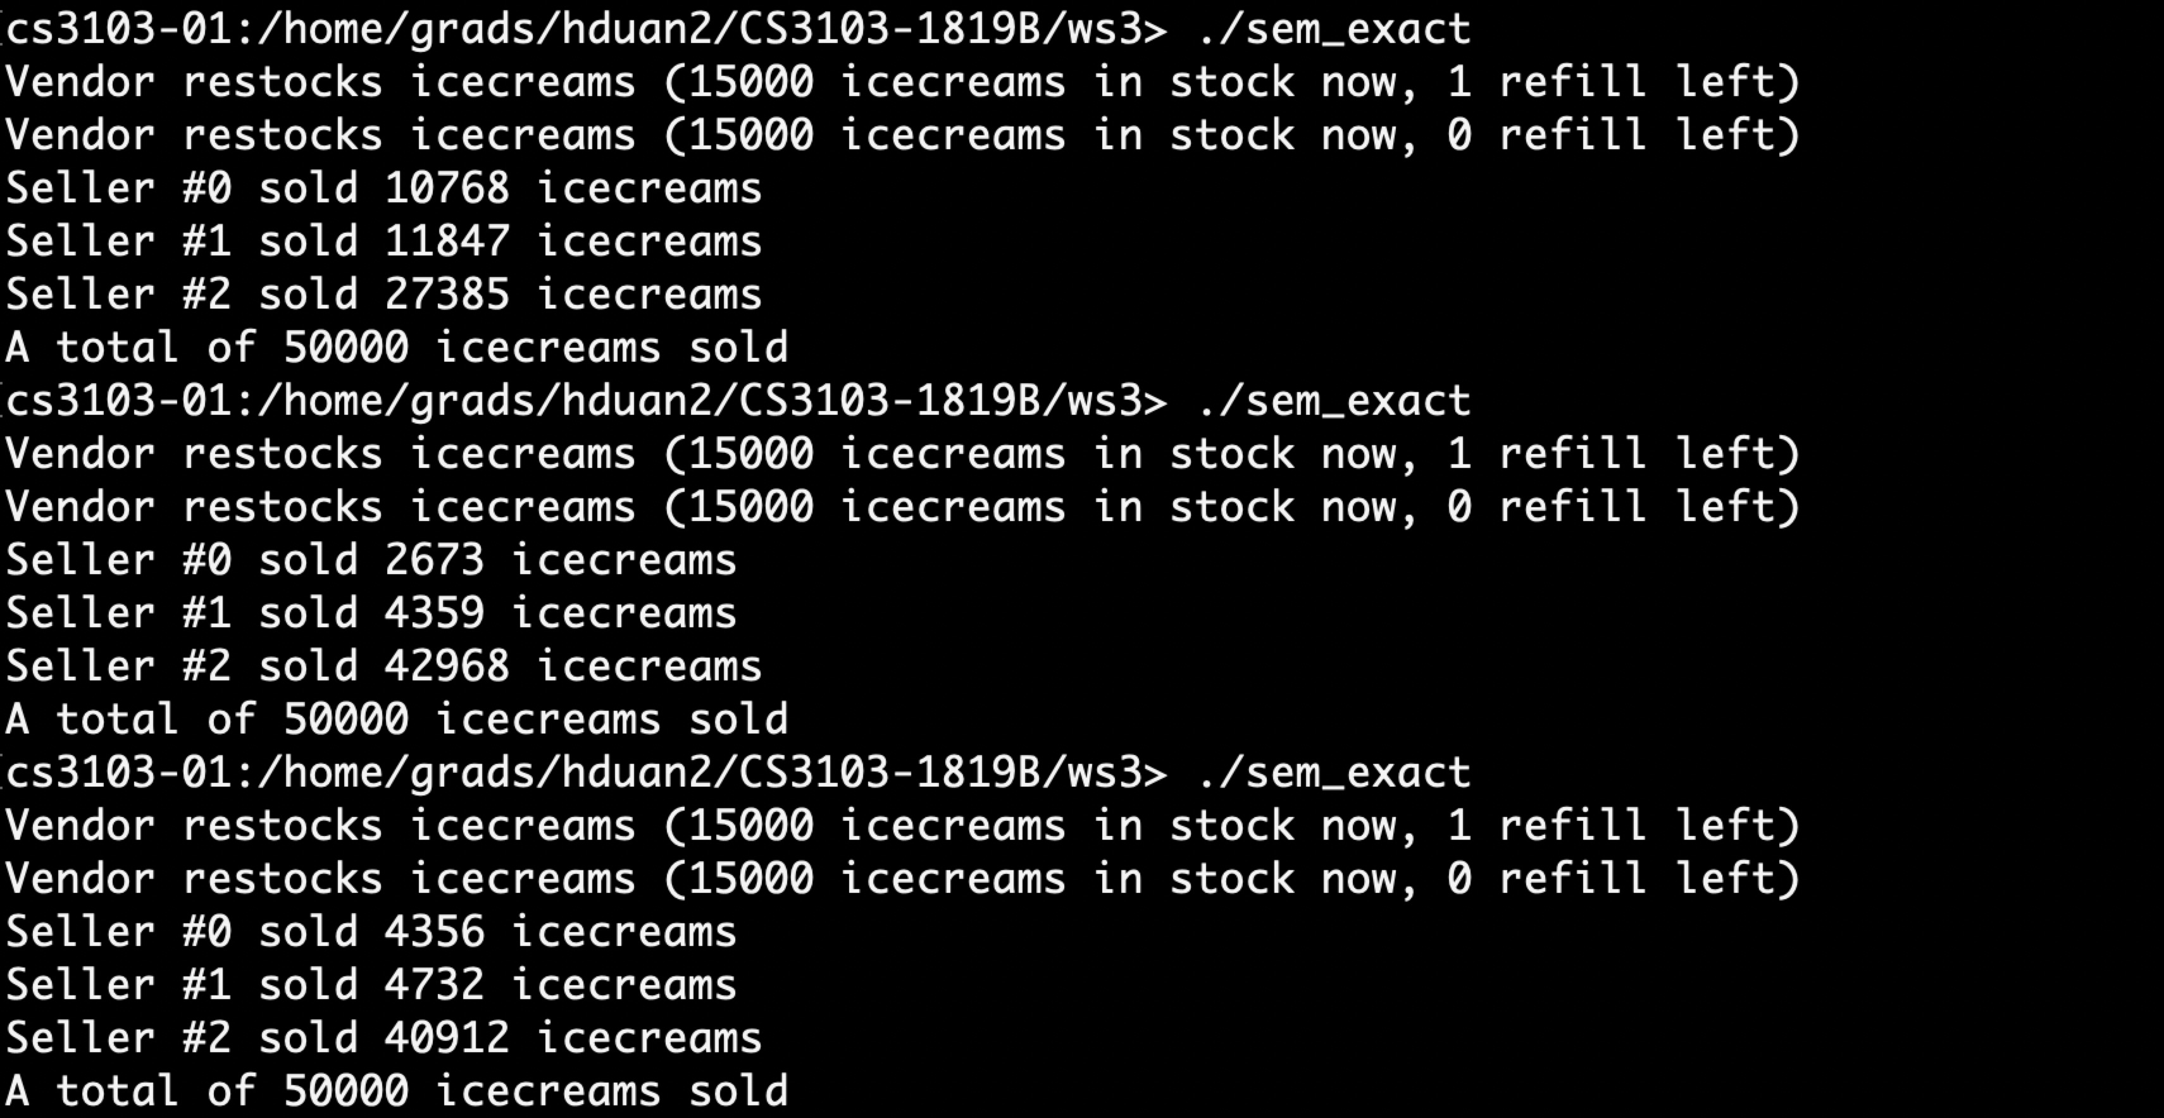
Semaphore – Output Example

